Slide 1
The main goal of the course is for you to be knowledgeable about the kinds of tools Data Scientists use, their examples, and get some hands-on time with a few key tools.
As such, you are not required to recall the name of every single tool covered in the course. However, be familiar with the categories or types of tools and 1 or 2 examples each type.

Slide 2
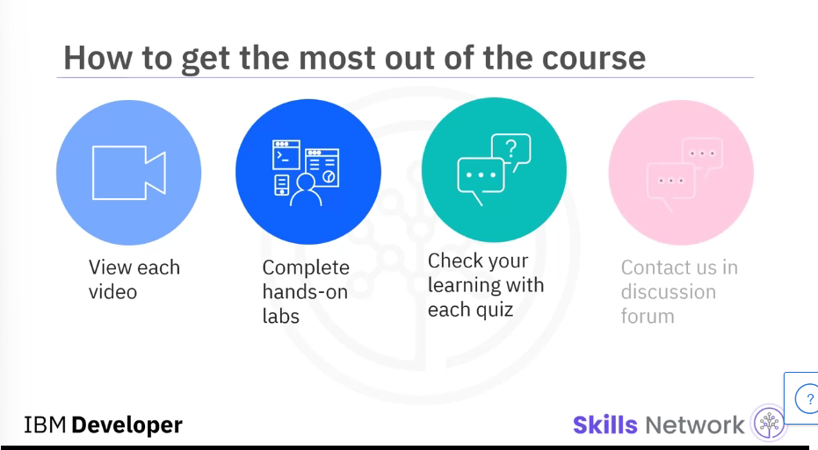

Slide 3
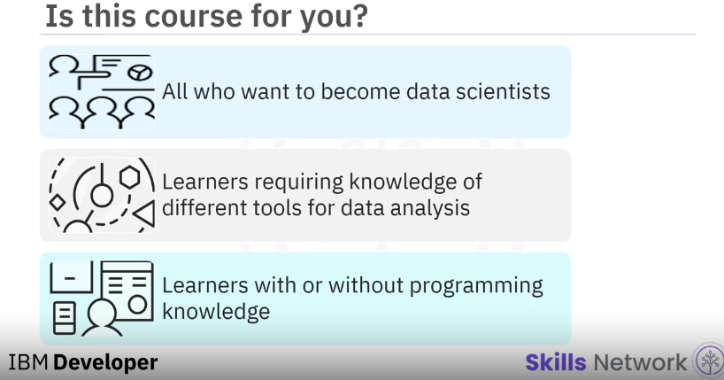

Slide 4
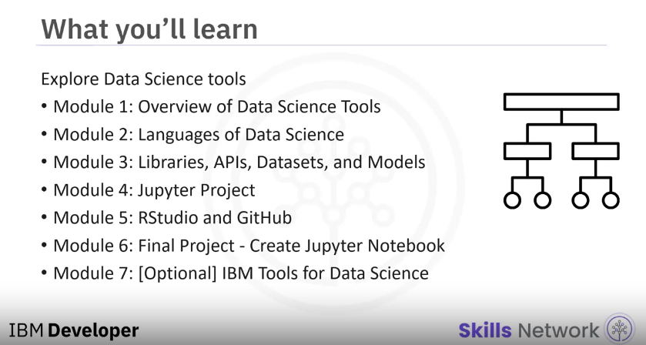

Slide 5
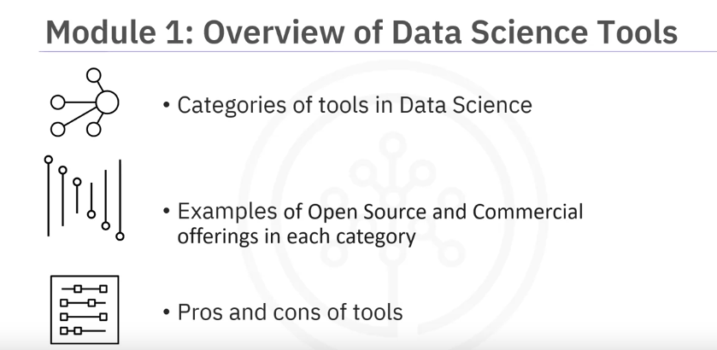

Slide 6
Module 1: Overview of Data Science Tools
In this module, you will learn about the different types and categories of tools that data scientists use and popular examples of each.
You will also become familiar with Open Source, Cloud-based, and Commercial options for data science tools.
Describe the components of a Data Scientist's toolkit and list various tool categories
List examples of Open Source, Commercial, and Cloud-based tools in various categories

Slide 7
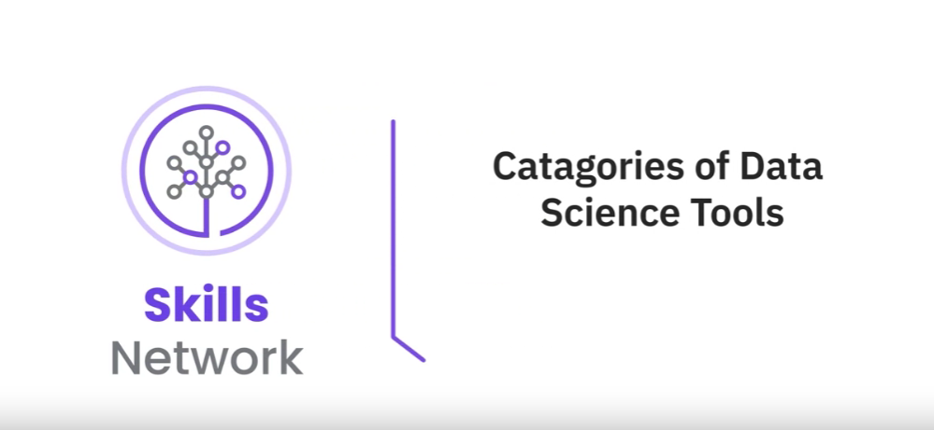

Slide 8
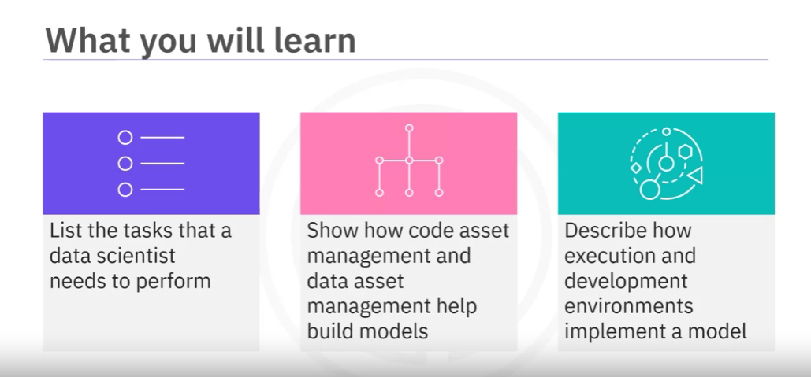

Slide 9
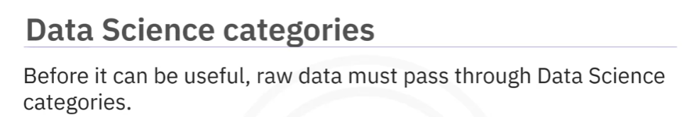
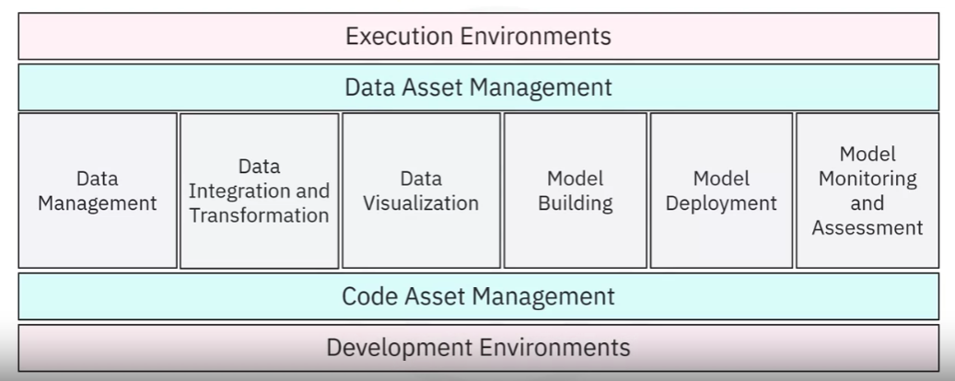

Slide 10
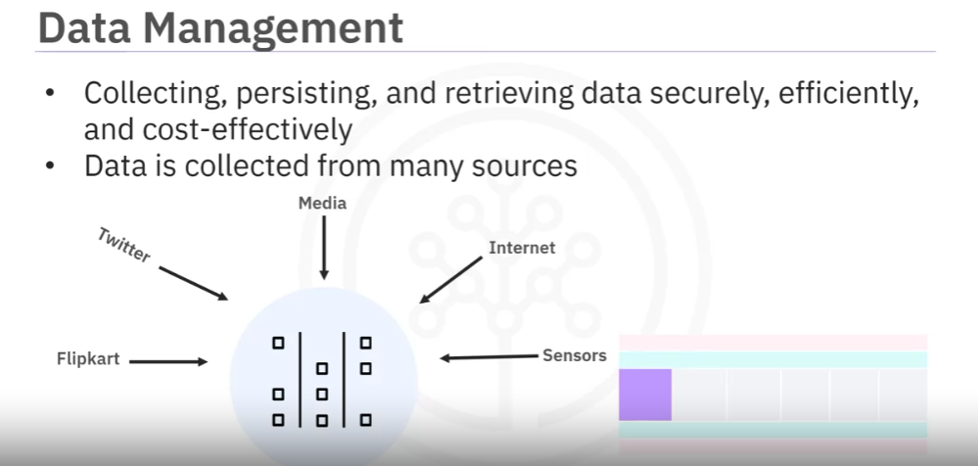

Slide 11
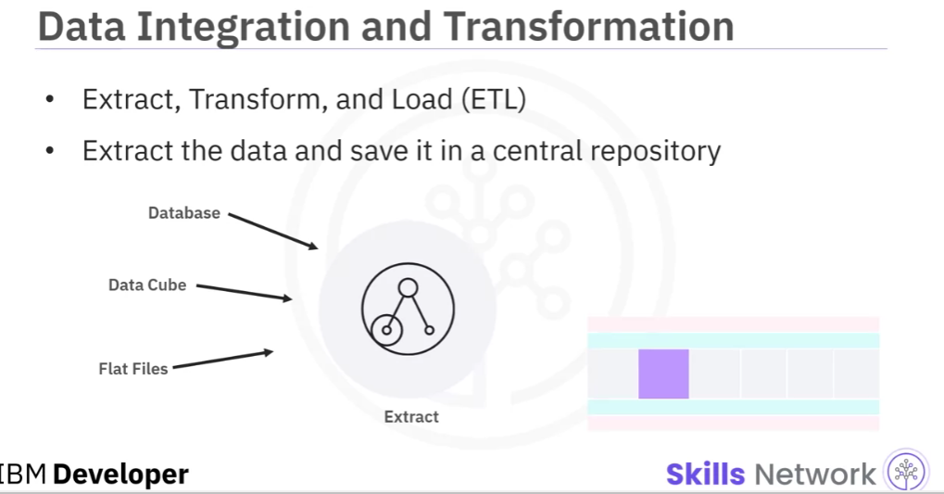

Slide 12
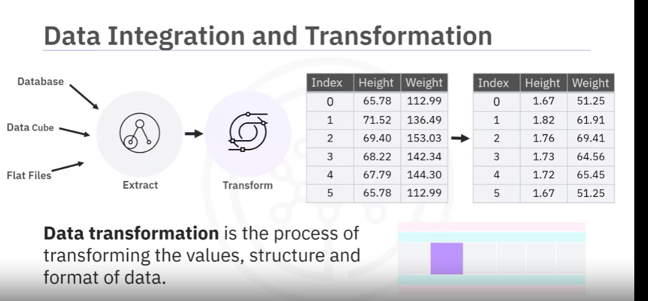

Slide 13
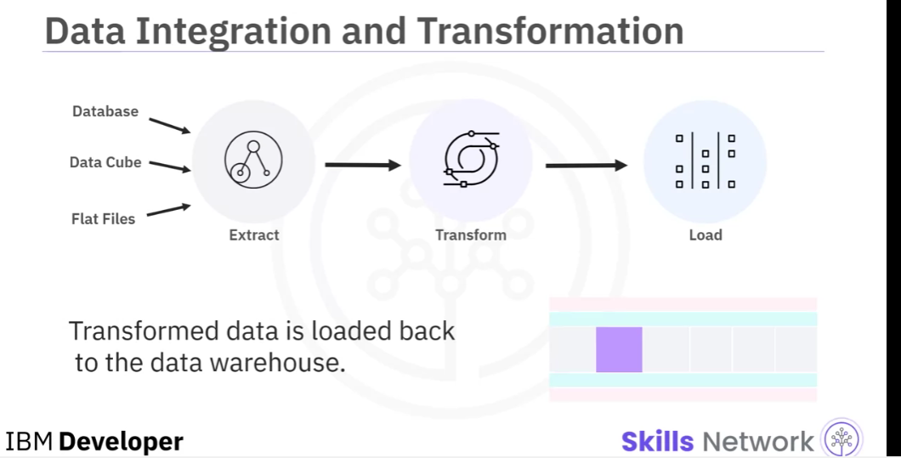

Slide 14
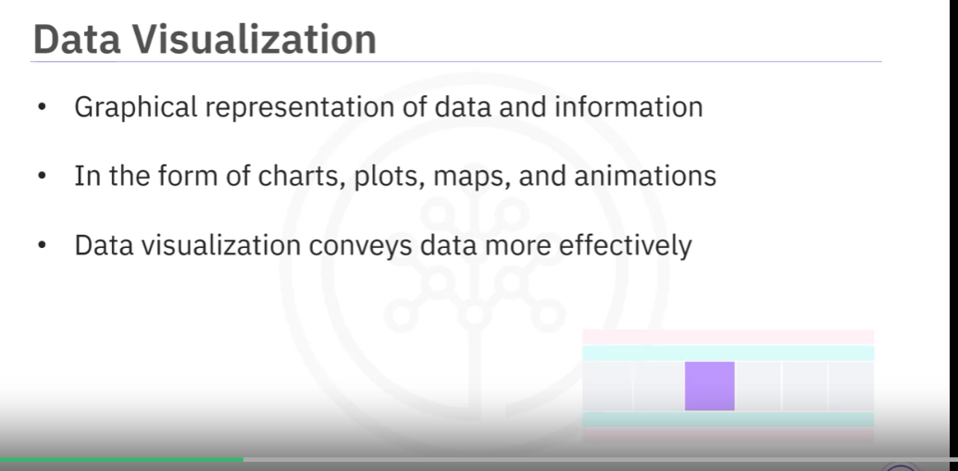

Slide 15
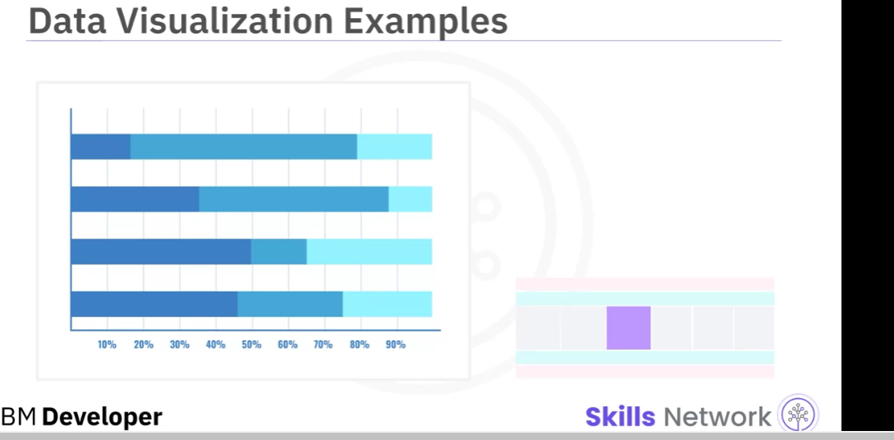
Notes:
Bar chart, which compares the size of each component

Slide 16
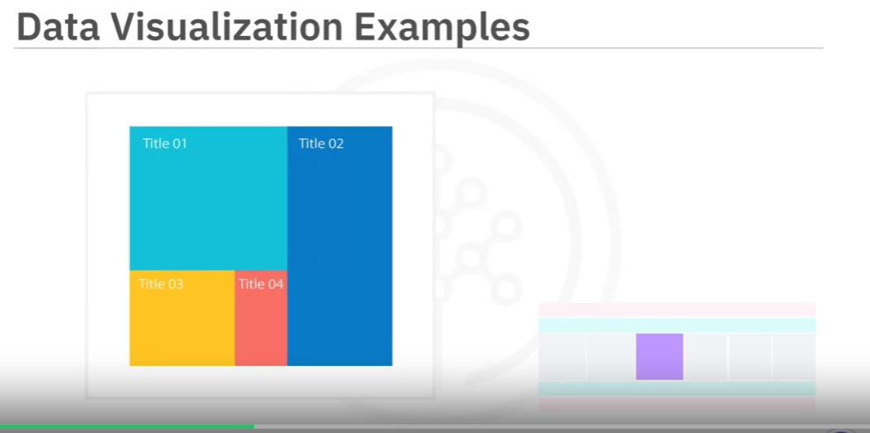
Notes:
a treemap, which displays hierarchy data

Slide 17
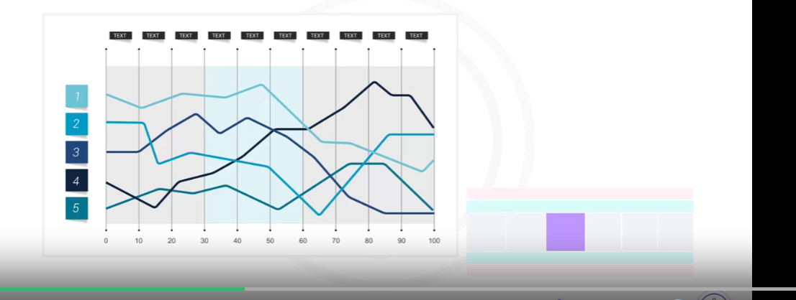
Notes:
a line chart, which plots a series of data points over time

Slide 18
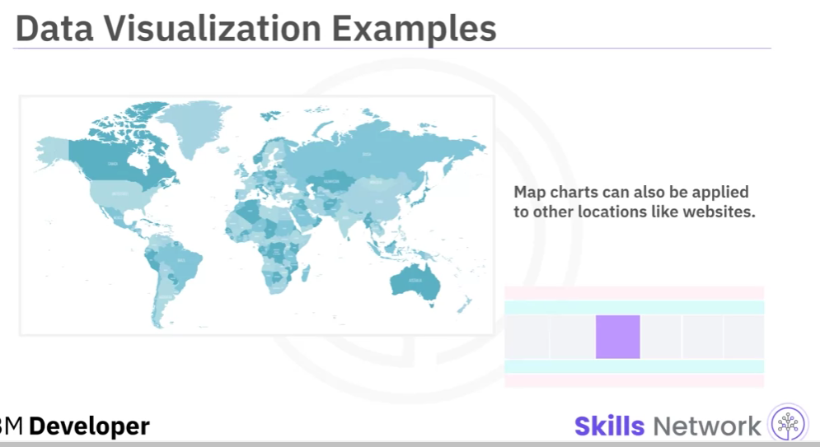
Notes:
a map chart, which displays data by location.
Map charts can also be applied to other locations like websites.

Slide 19
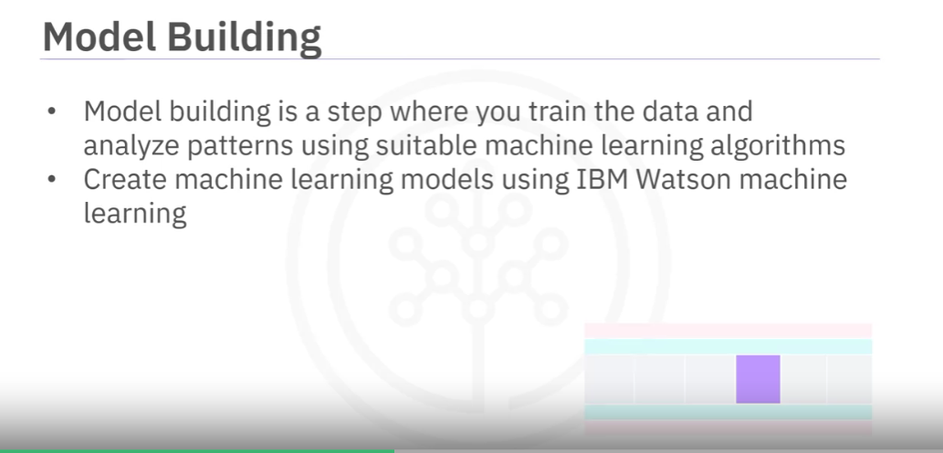

Slide 20
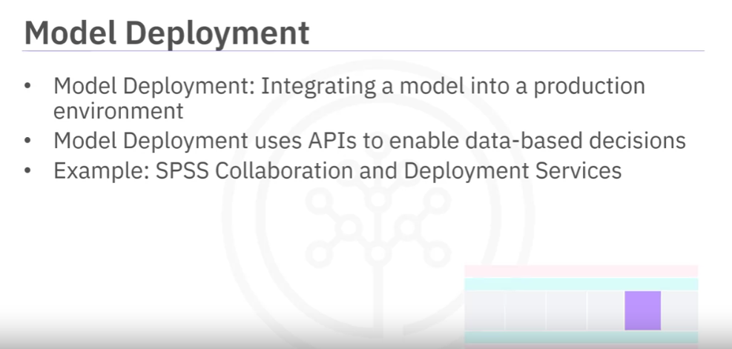

Slide 21
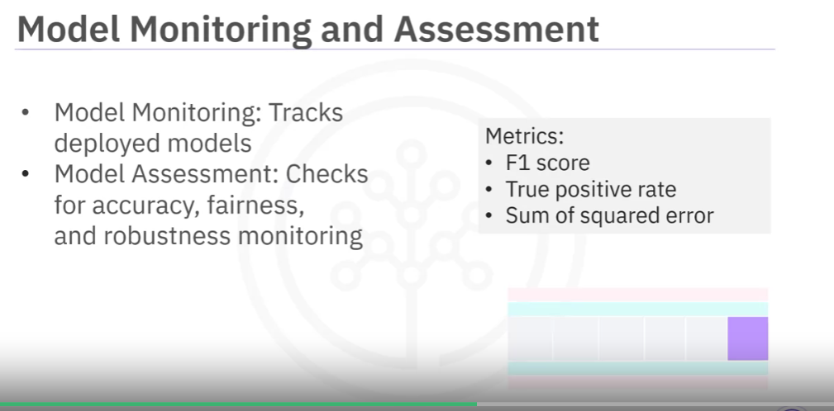

Slide 22
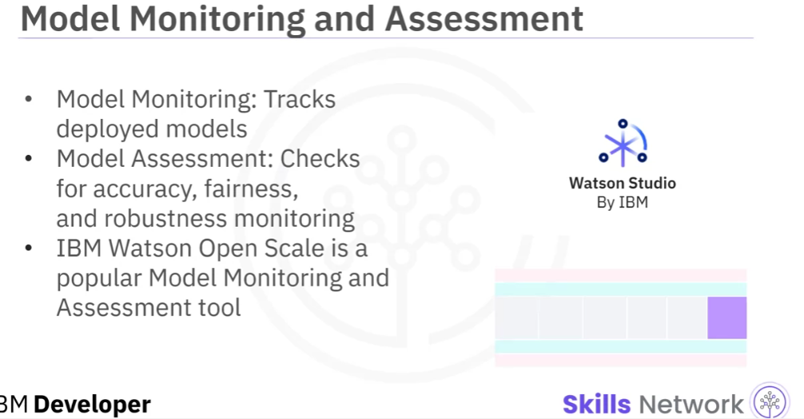

Slide 23
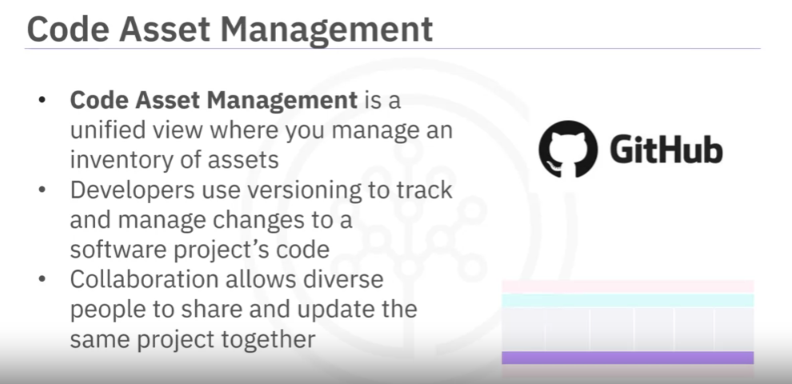

Slide 24
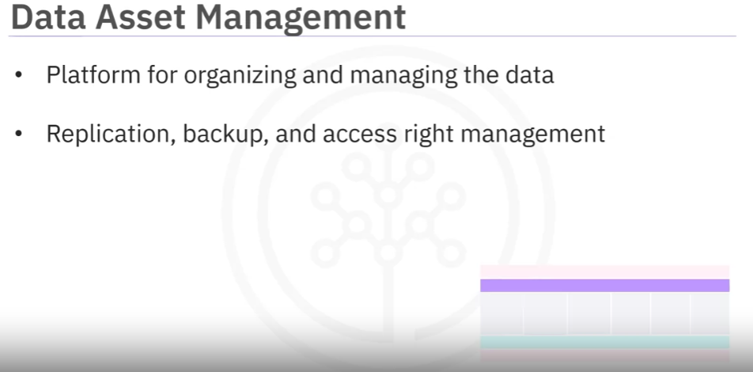

Slide 25
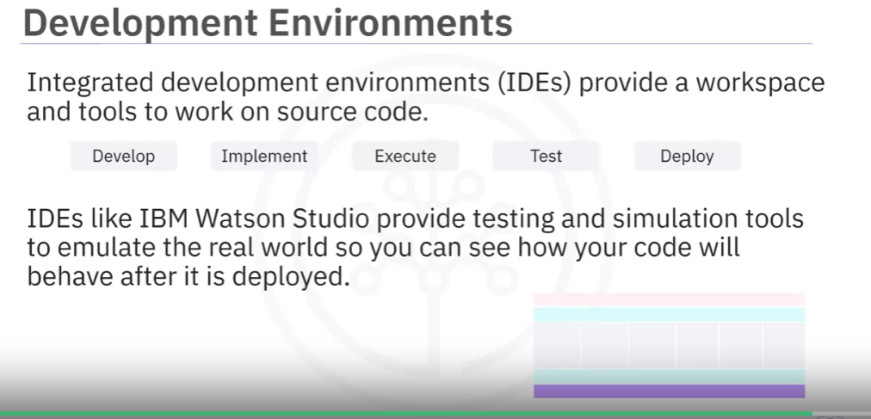

Slide 26
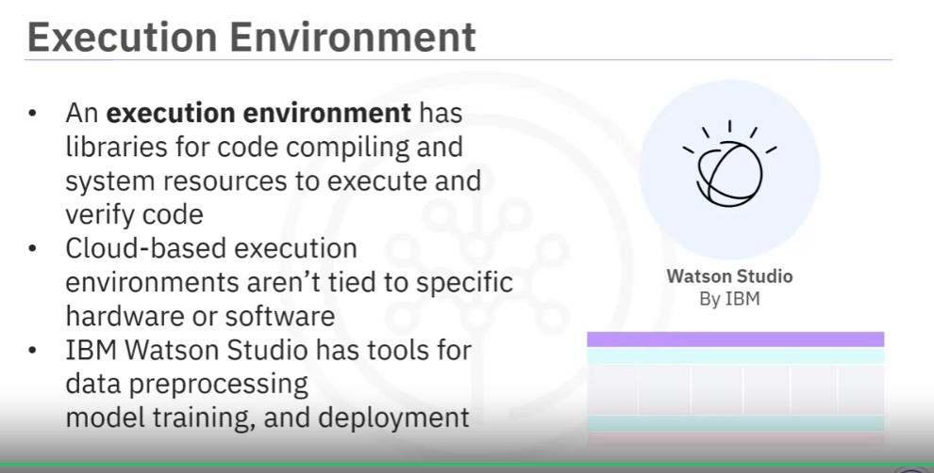

Slide 27
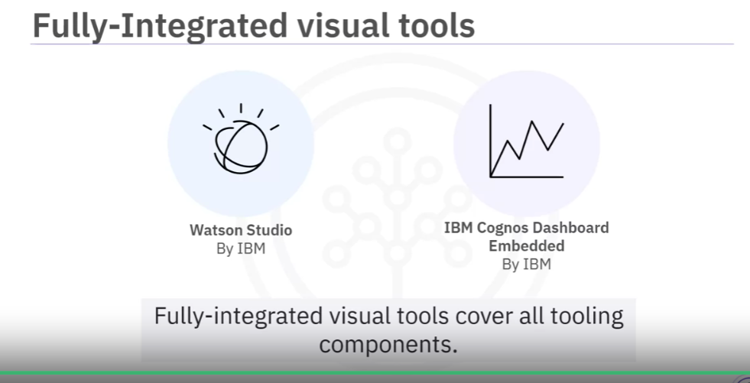

Slide 28
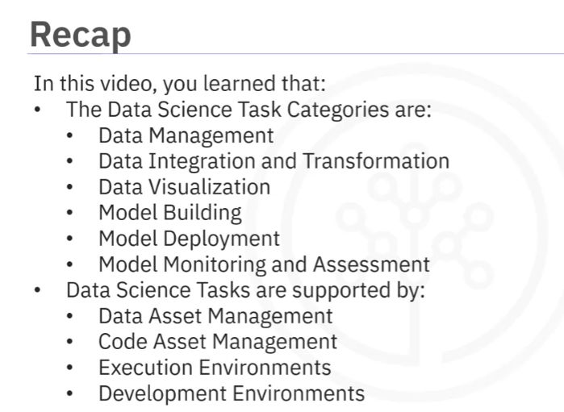

Slide 29
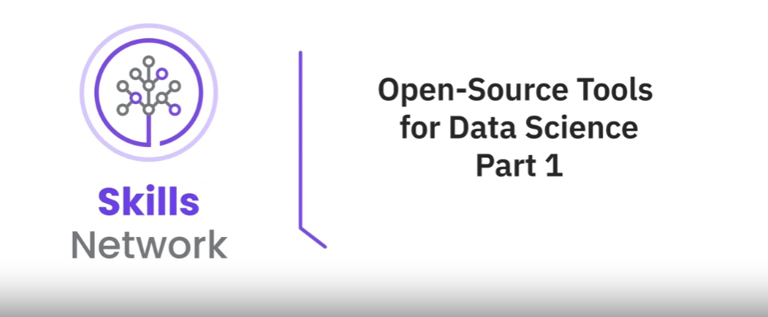

Slide 30
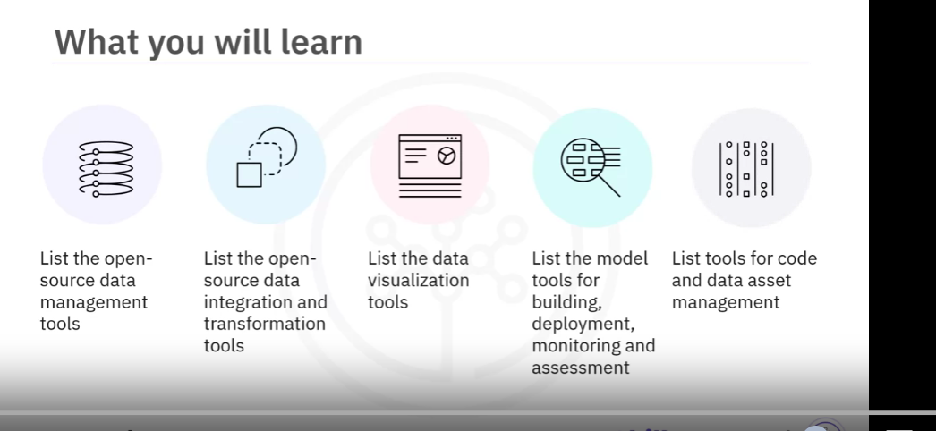

Slide 31
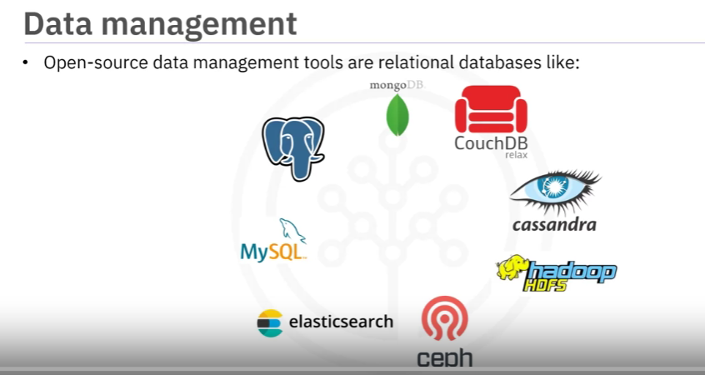

Slide 32
So, the most widely used open-source data management tools are
relational databases like MySQL and PostgreSQL.
Also, NoSQL Databases like MongoDB, Apache CouchDB, and Apache Cassandra.
file-based tools like the Hadoop File System
Cloud File systems like Ceph.
You also have an elastic search tool that stores text data, including the creation of a search index for fast document retrieval.

Slide 33
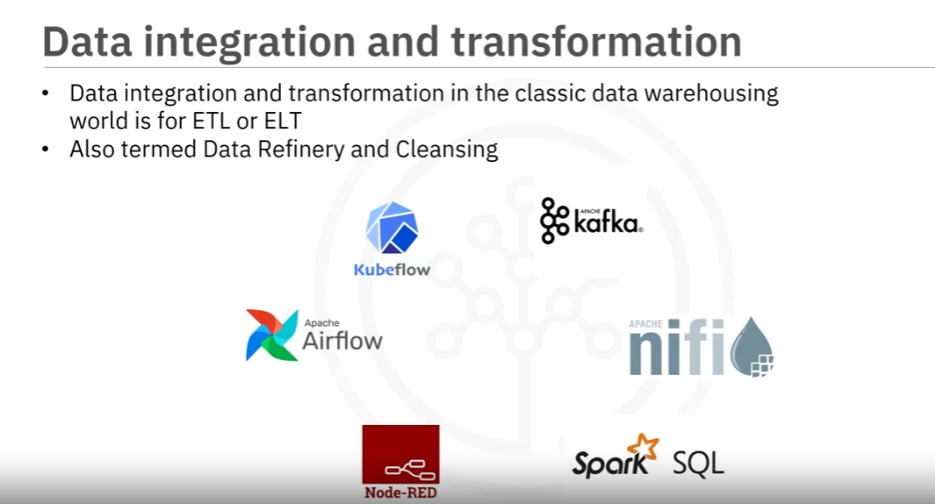

Slide 34
the task of data integration and transformation in the classic data warehousing world is to
Extract, Transform, and Load (ETL).
Data scientists often propose Extract, Load, Transform (ELT) as data is dumped somewhere,
and the data engineer or data scientist handles the transformation of the data.
Another term for this process emerged: Data Refinery and Cleansing.
The most widely used open-source data integration and transformation tools are the following:
Apache AirFlow, which was created by Airbnb originally.
KubeFlow, which allows the execution of data science pipelines on top of Kubernetes.
Apache Kafka, which originated from LinkedIn.
Apache Nifi, which delivers a very nice visual editor.
Apache SparkSQL, lets you use ANSI SQL and scales up to compute clusters of
thousands of nodes and NodeRED also brings a visual editor.
In addition, NodeRED is so low in resource consumption that
it even runs on tiny devices like a Raspberry Pi

Slide 35
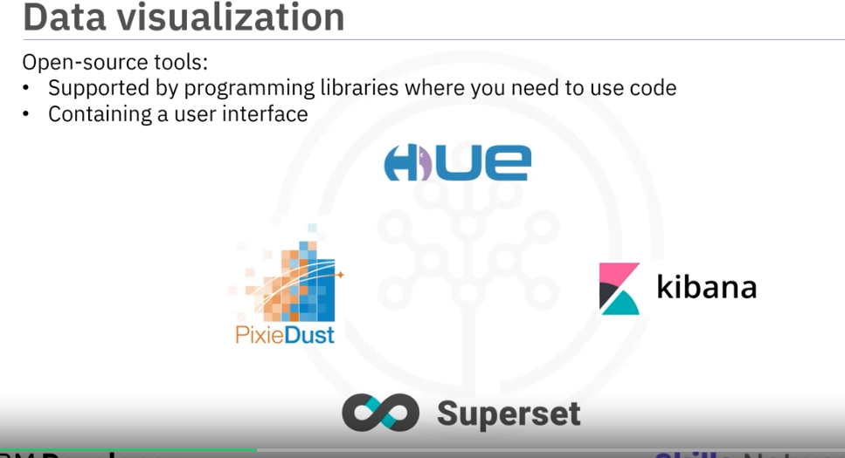

Slide 36
Now let’s discuss the most widely used open-source data visualization tools.
You must distinguish between programming libraries
where you must use code or tools containing a user interface.
Pixie Dust is also a library but has a user interface that facilitates plotting in Python.
A similar approach uses Hue, which can create visualizations from SQL queries.
Whereas Kibana, a data exploration, and visualization web application is limited to Elasticsearch (data provider).
And finally, Apache Superset is a data exploration and visualization web application.

Slide 37
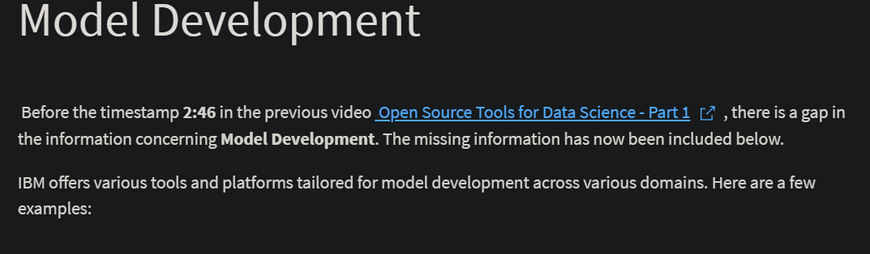
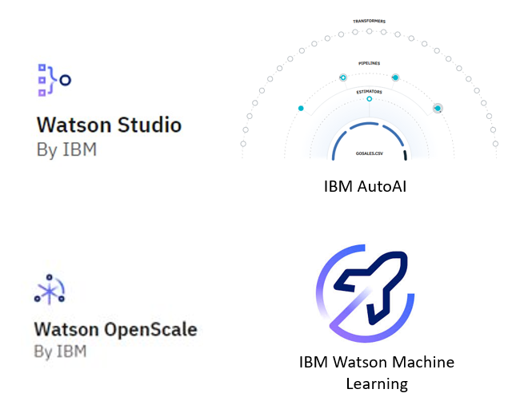

Slide 38
IBM Watson Studio: Engineered as an integrated environment, Watson Studio simplifies developing, training, and deploying models. It boasts support for multiple languages and frameworks, such as Python, R, and TensorFlow, alongside collaboration features, data preparation tools, and versatile deployment options.
IBM AutoAI: A notable feature embedded within Watson Studio, IBM AutoAI streamlines the machine learning model construction process. By dynamically exploring various algorithms and hyperparameters, it aims to identify the optimal model for a given dataset.
IBM Watson OpenScale: As a platform for overseeing and managing AI models in production, Watson OpenScale plays a pivotal role in ensuring model fairness, explainability, and bias mitigation. It furnishes insights into model performance and drift over time, facilitating informed decision-making.
IBM Watson Machine Learning: Watson Machine Learning, available as a service on the IBM Cloud platform, enables users to scale their training and deployment of machine learning models. It seamlessly supports popular frameworks like TensorFlow, PyTorch, and scikit-learn, and offers APIs for seamless integration with other applications.

Slide 39
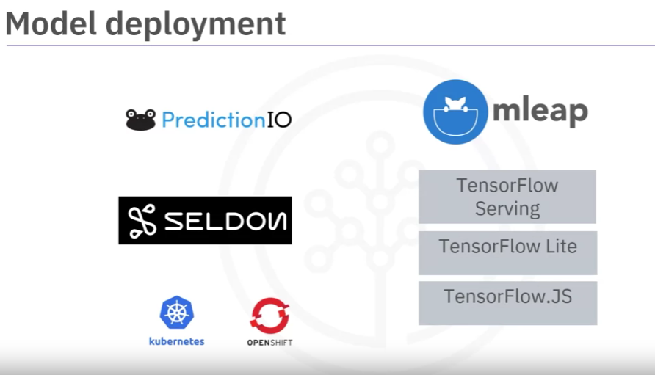

Slide 40
Model deployment is a crucial step.
Once you’ve created a machine learning model capable of predicting some critical aspects of the future, you should make it consumable by other developers and turn it into an API.
Apache PredictionIO currently only supports Apache Spark ML models for deployment,
but support for all libraries is on the roadmap.
Seldon is an interesting product since it supports nearly every framework including,
TensorFlow, Apache SparkML, R, and scikit learn.
Interestingly, it can run on top of Kubernetes and Redhat OpenShift.
Another way to deploy SparkML models is MLeap. Finally,
TensorFlow can serve any tensor flow model using the TensorFlow service.
It can be an embedded device like a Raspberry Pi or smartphone using
TensorFlow lite and deployed to a web browser using TensorFlow dot JS.

Slide 41
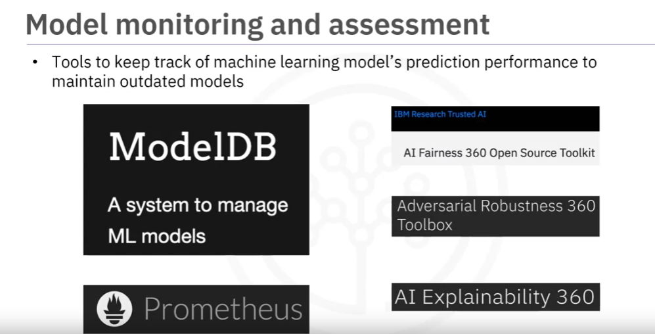

Slide 42
Model monitoring is an important step as well. Once you’ve deployed a machine learning model,
you want to track its prediction performance while new data arrives to maintain outdated models.
Some examples are the following:
ModelDB is a machine model metadata base where information about the models is stored and queried. It natively supports Apache Spark ML Pipelines and scikit-learn.
A generic, multi-purpose tool called Prometheus is widely used as well. Although it is not specifically made for machine learning model monitoring, it is used for this purpose.
Model performance is measured by more than accuracy. Model bias against protected groups like gender or race is important as well.
The IBM AI Fairness 360 open-source toolkit detects and mitigates bias in machine learning models. These models, especially neural network-based deep learning models, can be subject to adversarial attacks where an attacker tries to mislead the model with manipulated data or by controlling it.

Slide 43
The IBM Adversarial Robustness 360 Toolbox detects vulnerability against adversarial attacks and leverages the model to be more robust.
Finally, machine learning modes are often considered as a black box applying some magic.
The IBM AI Explainability 360 toolkit addresses that problem by finding similar
examples in a dataset to be presented to an end-user for manual comparison.
IBM AI Explainability 360 toolkit can also address the training of a simpler
machine learning model to explain the responsibility of different
input variables directed toward the final decision of the model.

Slide 44
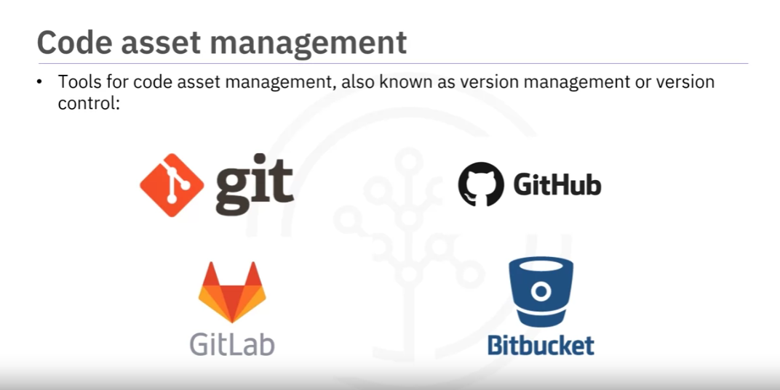

Slide 45
So, the choice of code asset management tools has become quite simple.
Git is now the de facto standard for code asset management, also known as version management or version control.
Around Git emerged several services.
The most prominent is GitHub, but the runner-up is GitLab, with the advantage
that the platform is entirely open source and can be hosted and managed on your own.
Another choice is Bitbucket.

Slide 46
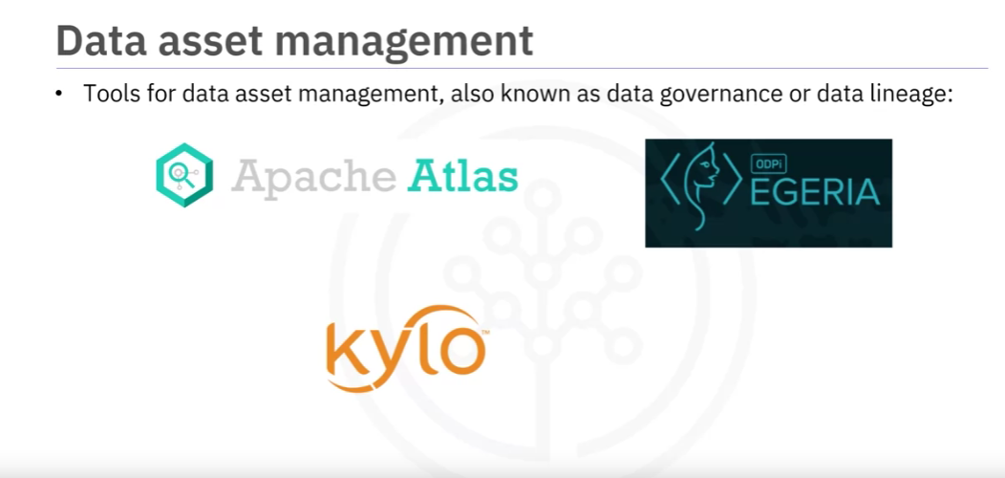

Slide 47
Data asset management, also known as data governance or data lineage, is a crucial part of enterprise-grade data science.
Data has to be versioned and annotated with metadata. Apache Atlas is such a tool supporting this task.
Another interesting project is ODPi Egeria,
managed through the Linux Foundation, is an open ecosystem offers a set of open APIs,
types, and interchange protocols that metadata repositories use to share and exchange data.
And finally, Kylo is an open-source data management software platform,
with extensive support for data asset management tasks.

Slide 48
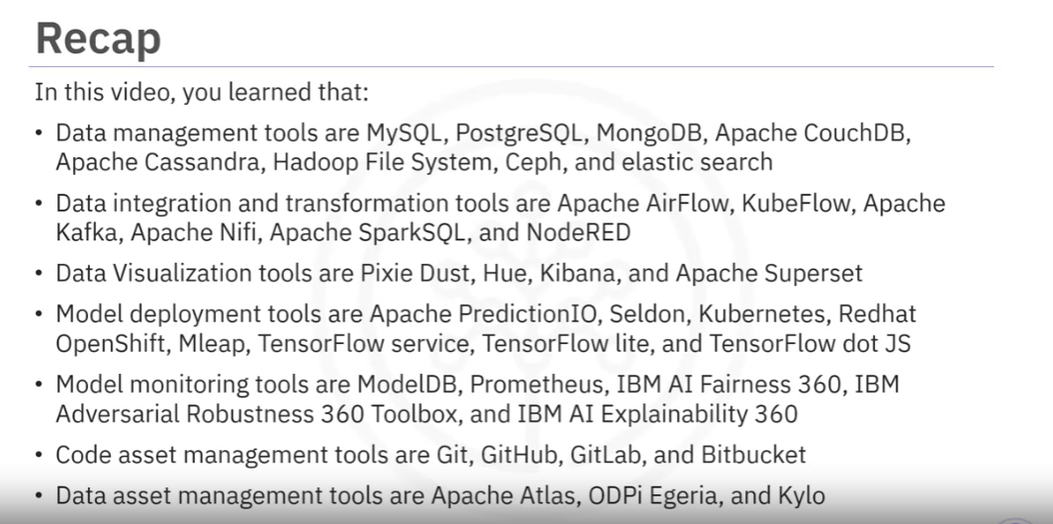

Slide 49
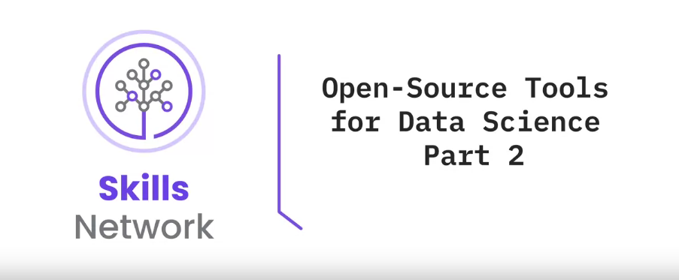

Slide 50
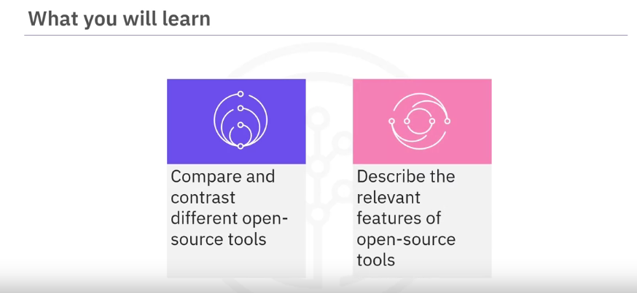

Slide 51
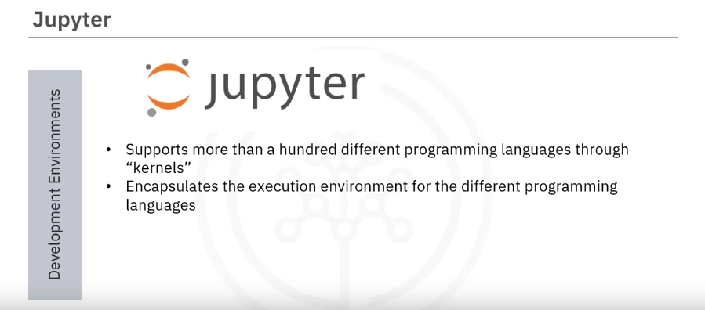
Currently, the most famous development environment data scientists are using is “Jupyter,”
which emerged as a tool for interactive Python programming.

Slide 52
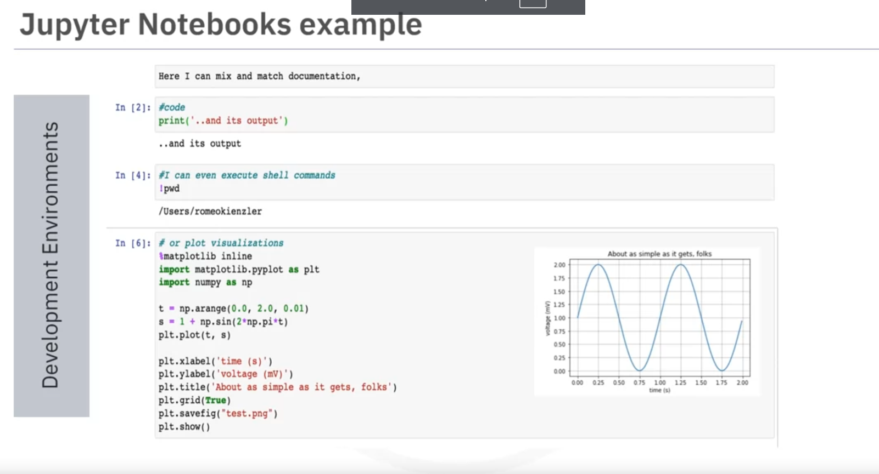
A key property of Jupyter Notebooks is to unify documentation, code, output from the code,
shell commands, and visualizations in a single document.

Slide 53
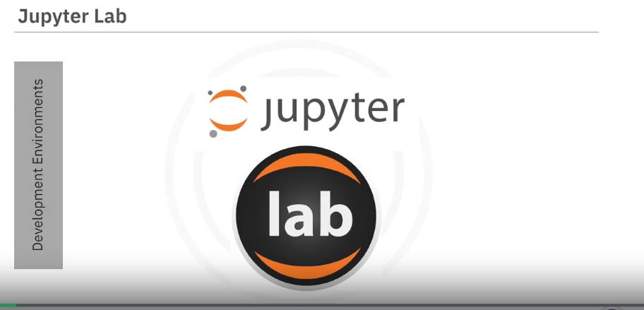
Jupyter lab is the next version of Jupyter Notebooks, and in the long term will replace Jupyter Notebooks.
The abundance of architectural changes makes Jupyter more modern and modular

Slide 54
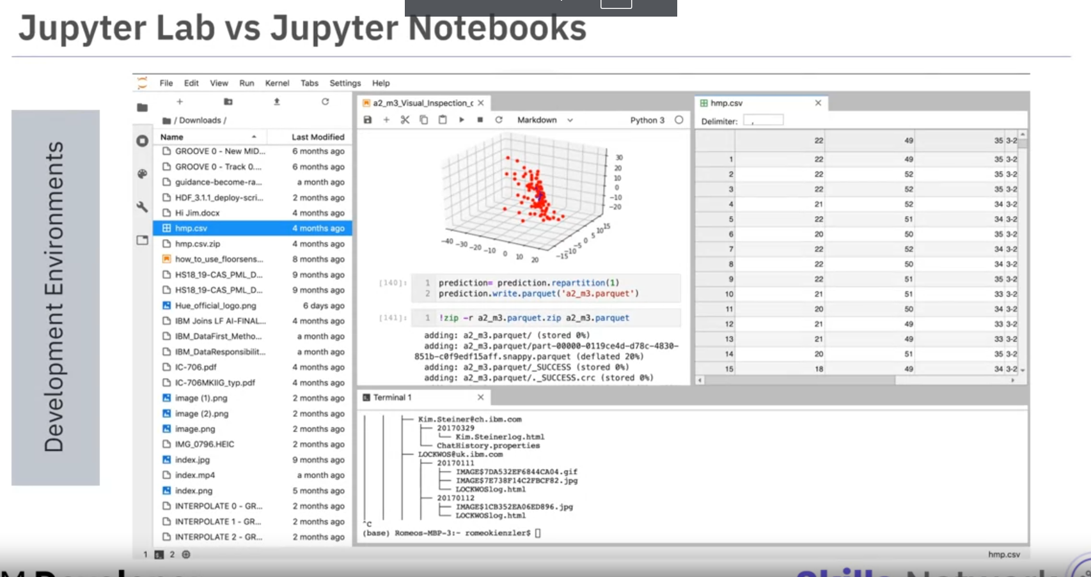
From a user’s perspective, the main difference between Jupyter Lab and
Jupyter Notebooks is the ability to open different types of files,
including Jupyter Notebooks, data, and terminals, and then arrange them on the canvas.

Slide 55
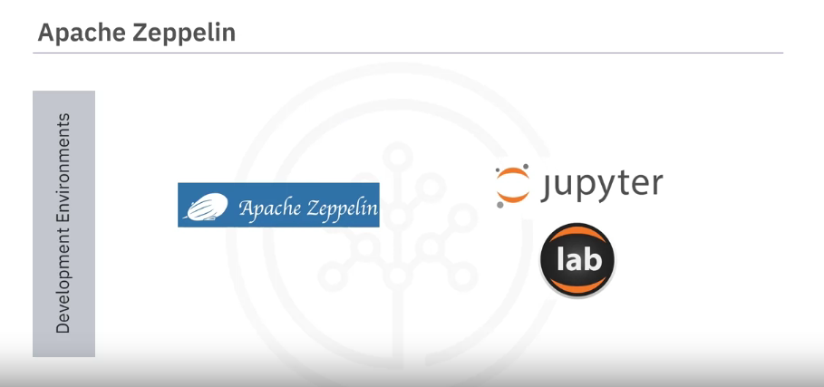
Although it has been reimplemented from scratch,
Apache Zeppelin was inspired by Jupyter Notebooks and provides a similar experience

Slide 56
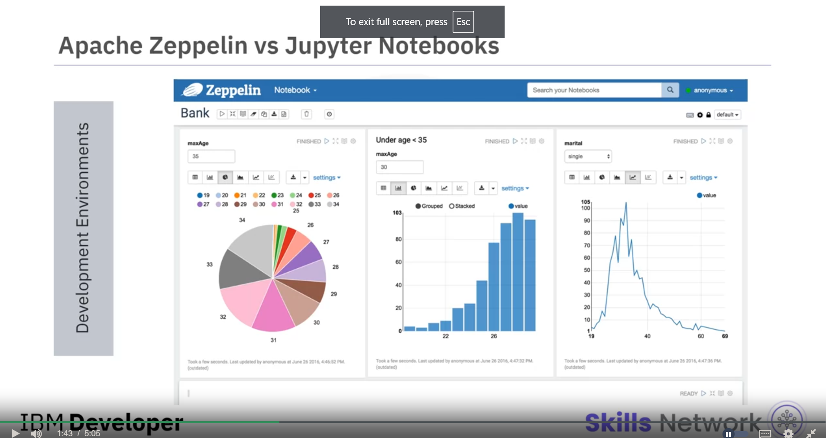
One key differentiator is the integrated plotting capability. In Jupyter Notebooks, you are required to use external libraries in Zeppelin,
and plotting doesn’t require coding.
You can also extend the capabilities by using additional libraries.

Slide 57
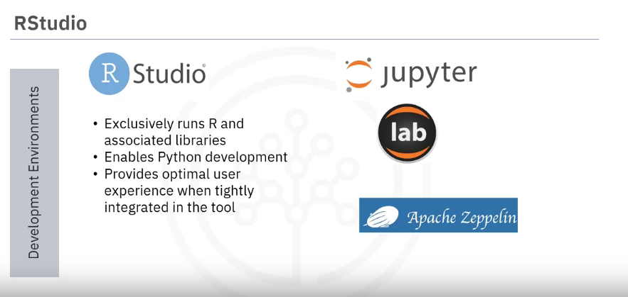
RStudio is among the oldest development environments for statistics and data
science. RStudio has its origins in the year 2011.

Slide 58
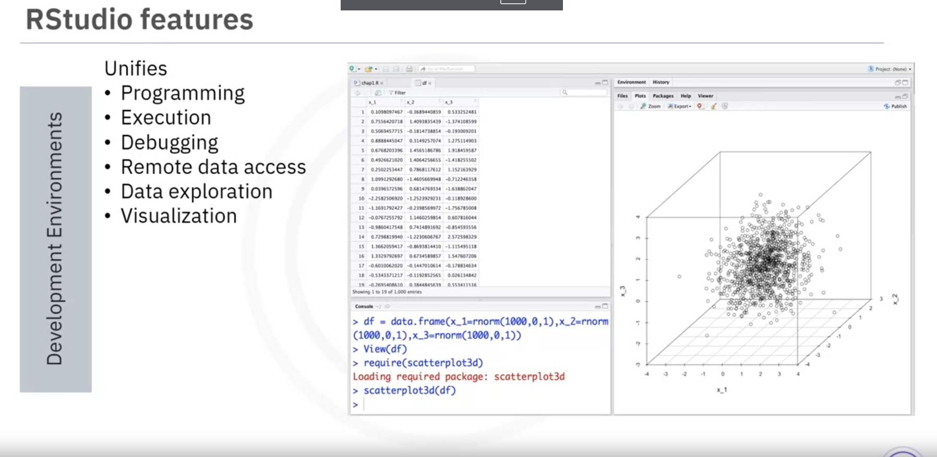

Slide 59
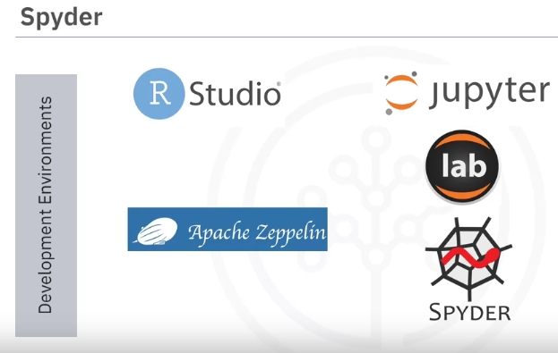
Finally, Spyder tries to mimic the behavior of RStudio to bring
its functionality to the Python world.
Although not at par with the functionality of RStudio,
data scientists consider it as an alternative. In the Python world, Jupyter is used more.

Slide 60

This diagram shows that Spyder integrates code,
documentation, and visualizations, among others, into a single canvas

Slide 61

Sometimes your data doesn’t fit into a single computer’s storage or main memory capacity.
Therefore, cluster execution environments exist.
The extensively famous Apache Spark is among the most active Apache projects
that are used across all industries, including many Fortune 500 companies.
The key property of Apache Spark is linear scalability. This means that if you double the number of servers in a cluster, you’ll roughly double its performance

Slide 62

Apache Flink was developed after Apache Spark continued to gain market share.
The key difference between Apache Spark and Apache Flink is that Apache Spark is a batch
data processing engine, capable of processing vast amounts of data one by one or file by file.
Whereas Apache Flink is a stream-processing image with its main focus on processing real-time data streams. Although both engines support both data processing paradigms, at the same time, Apache Spark is the choice for most use cases.

Slide 63

After Apache Spark and Apache Flink,
Ray is one of the latest developments in the data science execution environments and has a clear focus on large-scale deep learning model training.

Slide 64

Let’s look at open-source tools for data scientists, which are fully integrated and visual. This means no programming knowledge is necessary.
The tools support a subset of important tasks that include data integration and transformation, data visualization, and model building.

Slide 65

KNIME originated from the University of Konstanz in 2004

Slide 66

As you can see, KNIME has a visual user interface with drag-and-drop capabilities. It has built-in visualization capabilities. In addition,
it can be extended by programming in R and Python and even has connectors to Apache Spark

Slide 67

Orange is another representative of this group of tools. It is less flexible than KNIME but is easier to use.

Slide 68


Slide 69


Slide 70
https://cf-courses-data.s3.us.cloud-object-storage.appdomain.cloud/IBM-DS0130EN-SkillsNetwork/storyline/Open%20Source%20Tools/story.html?origin=www.coursera.org
Test Your knowledge

Slide 71



Slide 72


Slide 73
Let’s again look at the overview of different tool categories.
Since cloud products are a newer species, they follow the trend of having multiple tasks integrated in tools.
This integration is applicable for the tasks marked green in the diagram.

Slide 74


Slide 75


Slide 76


Slide 77


Slide 78
another example is H2O Driverless AI.
Although it is a product you download and install, there exists a one-click deployment
for the standard cloud service providers.
Since the cloud provider does not do operations and maintenance, as with Watson Studio, Open Scale, and Azure Machine Learning, this delivery model should be distinct from Platform or Software as a service - PaaS or SaaS.

Slide 79


Slide 80


Slide 106


Slide 107
Module 2: Languages of Data Science
This module will bring awareness about the criteria determining which language you should learn.
You will learn the benefits of Python, R, SQL, and other common languages such as Java, Scala, C++, JavaScript, and Julia.
You will explore how you can use these languages in Data Science. You will also look at some sites for more information about the languages.

Slide 108
Learning Objectives
Identify the criteria and roles for determining the language to learn
Identify the users and benefits of Python.
Identify the users and uses of the R language.
Define SQL elements and list their benefits.
Review languages such as Java, Scala, C++, JavaScript, and Julia.
List the global communities for connecting with other users.

Slide 109

Module 3: Packages, APIs, Data Sets and Models
This module will give you in-depth knowledge of different libraries, APIs, dataset sources and models used by data scientist

Slide 110
Learning Objectives
List examples of the various libraries: scientific, visualization, machine learning, and deep learning.
Define REST API to request and respond.
Describe data sets and sources of data.
Explore open data sets on the Data Asset eXchange.
Describe how to use a learning model to solve a problem.
List the tasks that a data scientist needs to perform to build a model.
Explore ML models in the Model Learning eXchange.

Slide 111


Slide 112
Module 4: Jupyter Notebooks and JupyterLab
This module introduces the Jupyter Notebook and JupyterLab. You will learn how to work with different kernels and the basic Jupyter architecture. In addition, you will identify the tools in an Anaconda Jupyter environment.
Finally, the module overviews cloud-based Jupyter environments and their data science features.

Slide 113
Learning Objectives
Describe how to use the notebooks in JupyterLab.
Describe how to work in a notebook session.
Describe the basic Jupyter architecture.
Describe how to work with kernels.
Identify tools in Anaconda Jupyter environments.
Describe cloud-based Jupyter environments and their data science features.

Slide 114


Slide 115
Module 5: RStudio and GitHub
This module will start with an introduction to R and RStudio and will end up with GitHub usage.
You will learn about the different R visualization packages and how to create visual charts using the plot function.
Further in the module, you will develop the essential conceptual and hands-on skills to work with Git and GitHub. You will start with an overview of Git and GitHub, creating a GitHub account and a project repository, adding files, and committing your changes using the web interface. Next, you will become familiar with Git workflows involving branches, pull requests (PRs), and merges. You will also complete a project at the end to apply and demonstrate your newly acquired skills.

Slide 116
Learning Objectives
Describe R capabilities and RStudio environment.
Use the inbuilt R plot function.
Explain version control and describe the Git and GitHub environment.
Describe the purpose of source repositories and explain how GitHub satisfies the needs of a source repository.
Create a GitHub account and a project repository.
Demonstrate how to edit and upload files in GitHub.
Explain the purpose of branches and how to merge changes.

Slide 117


Slide 118
Module 6: Final Project and Assessment
In this module, you will work on a final project to demonstrate some of the skills learned in the course. You will also be tested on your knowledge of various components and tools in a Data Scientist's toolkit learned in the previous modules.
Learning Objectives
Create a Jupyter Notebook with markdown and code cells
List examples of languages, libraries and tools used in Data Science
Share your Jupyter Notebook publicly on GitHub
Evaluate notebooks submitted by your peers using the provided rubric
Demonstrate proficiency in Data Science toolkit knowledge

Slide 119


Slide 120
Module7: IBM Watson Studio
This is as an optional module if you are interested in learning about and working with data science tools from IBM such as Watson Studio.
Learning Objectives
Find common resources in Watson Studio and IBM Cloud Pak for Data.
Create an IBM Cloud account, service, and project in Watson Studio.
Create and share a Jupyter Notebook.
Use different types of Jupyter Notebook templates and kernels on IBM Watson Studio.
Describe how to connect a Watson Studio account and publish a notebook in GitHub.

